Slide 1
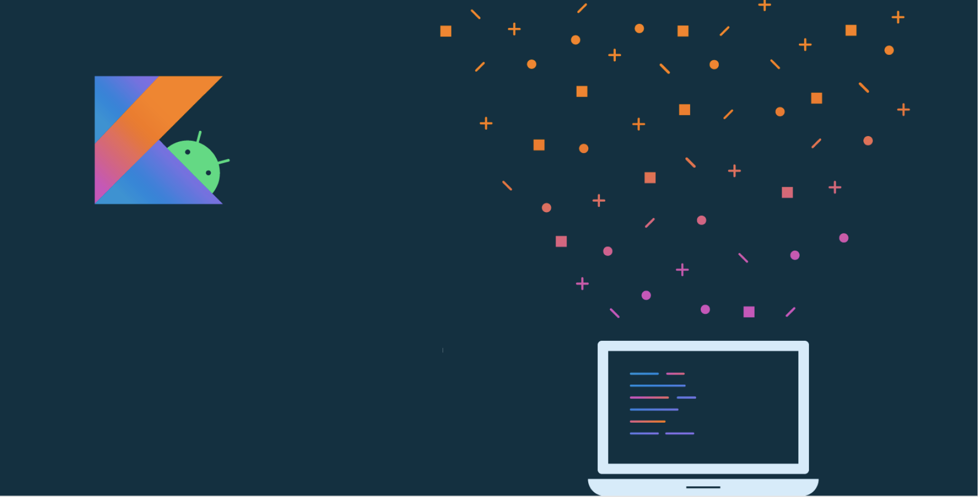
Lesson 4:
Build your first Android app

Slide 2
About this lesson
Lesson 4: Build your first Android app
Your first app
Anatomy of an Android app
Layouts and resources in Android
Activities
Make an app interactive
Gradle: Building an Android app
Accessibility
Summary

Slide 3
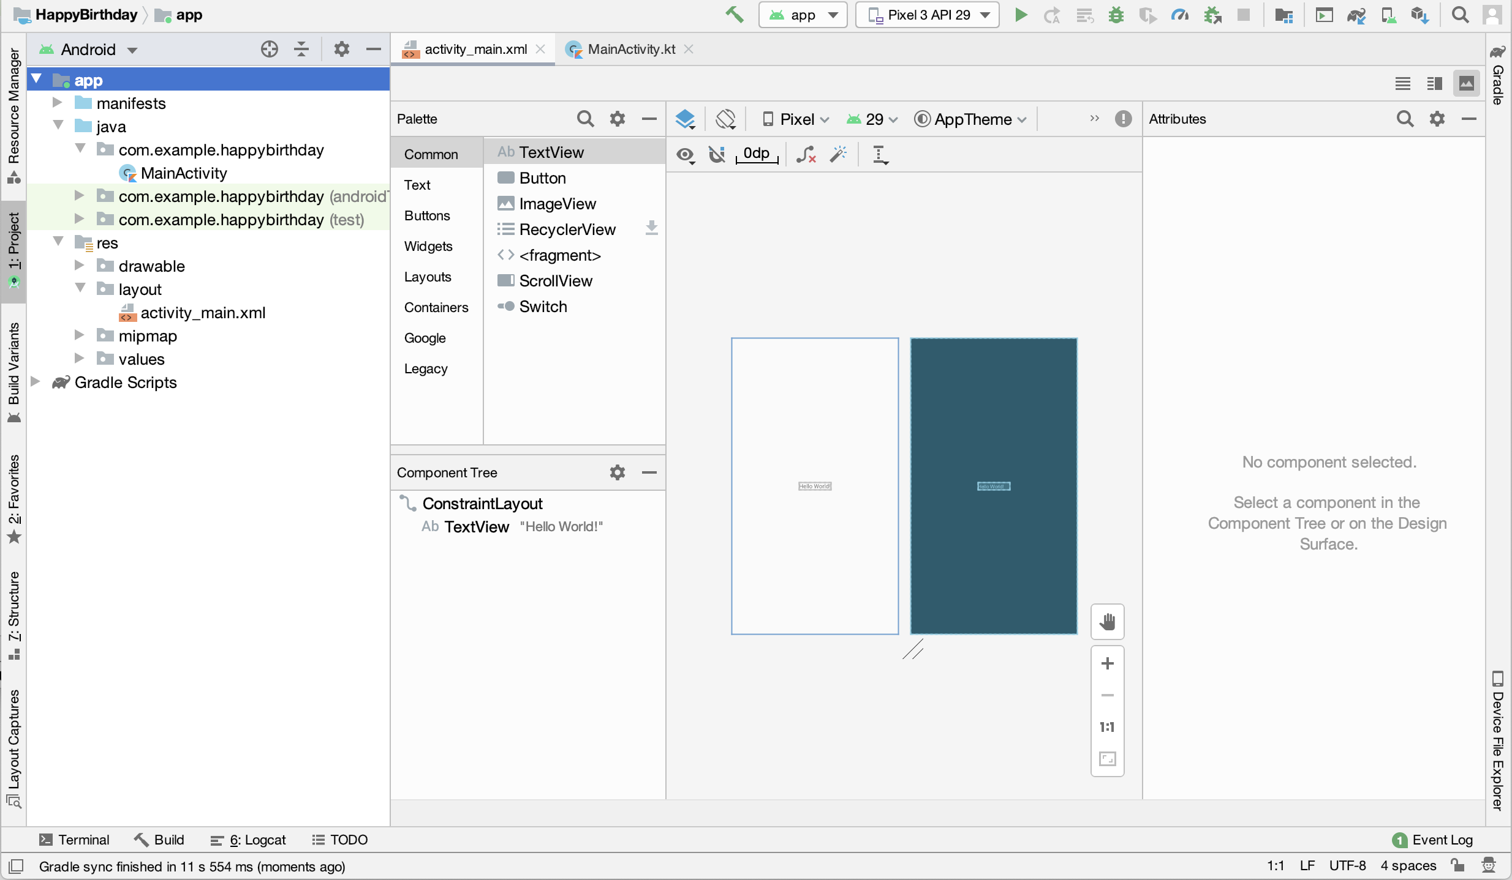
Android Studio
Official IDE for building Android apps
Notes:
This is Android Studio - the official integrated development environment (IDE) for Android development. It’s built on IntelliJ IDEA and it has lots of features to make it faster and easier to develop Android apps.
Installation instructions and a formal walkthrough will be in the labs. This lecture will focus more on high-level concepts.
Resource:
Download Android Studio and SDK tools

Slide 4
Your first app

Slide 5
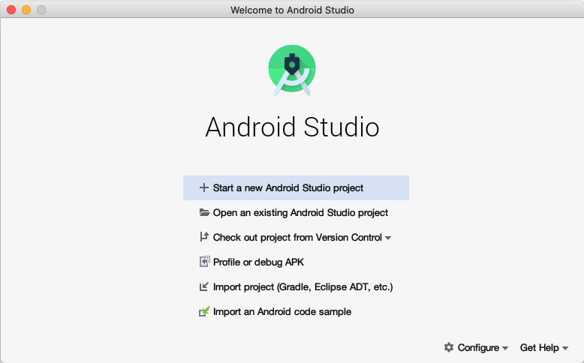
Open Android Studio
Notes:
When you open Android Studio, the Welcome to Android Studio dialog displays.

Slide 6
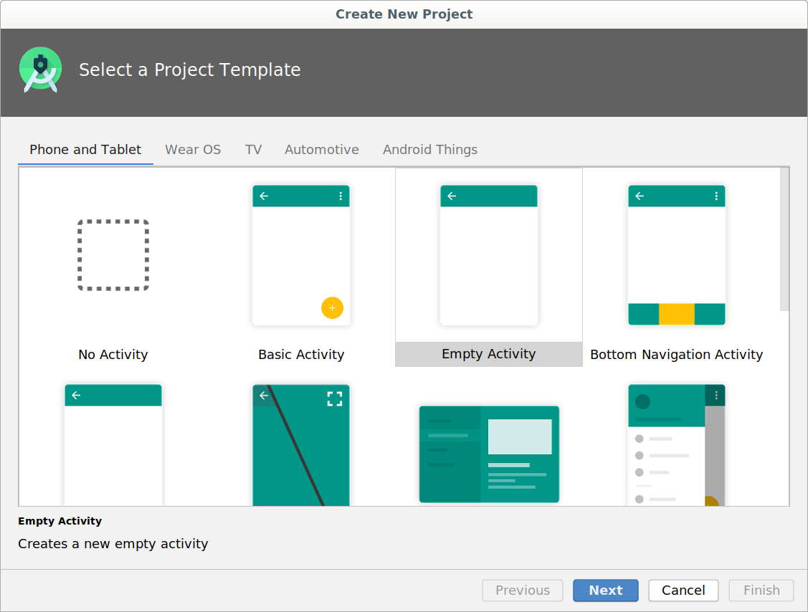
Create new project
Notes:
There are lots of templates here that contain starter projects to help you build different kinds of apps. We'll select the Empty Activity template to give us a simple working app.

Slide 7
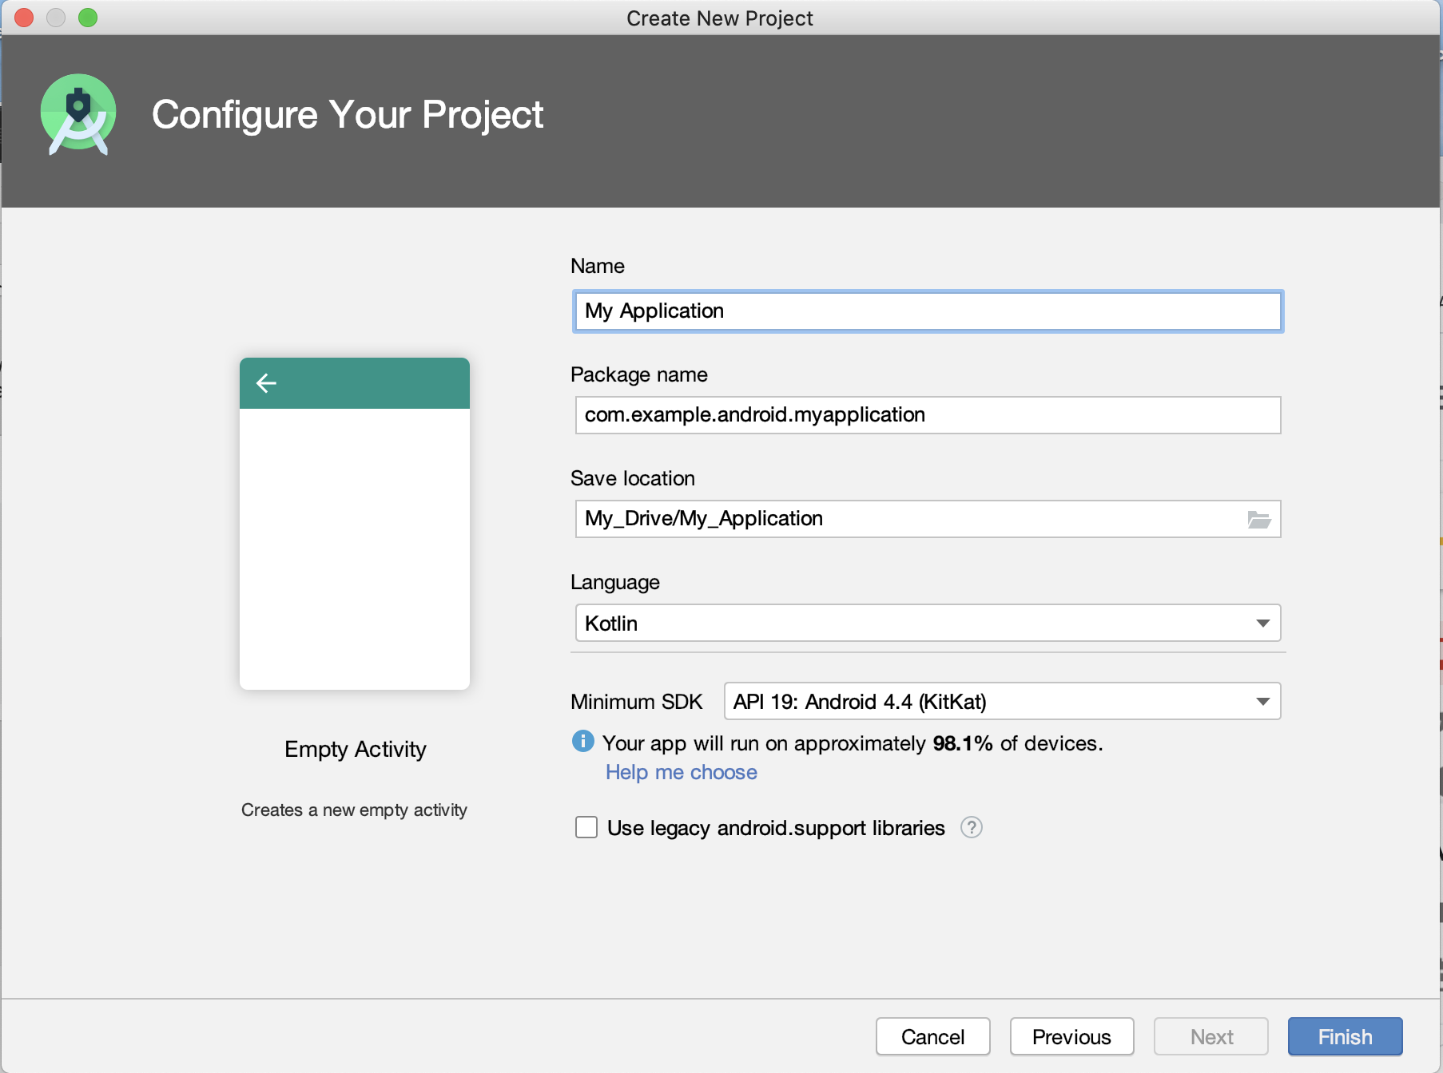
Enter your project details
Notes:
Name - Enter a name for your application.
Package name - A globally unique name that represents your app, similar to a web address. This often is the company web domain (defaults to android.example.com) plus the name of the app. If you are not planning to publish your app, you can use the default. You can change this later, but it's extra work. This will also be the default Java and Kotlin package for your source code.
Save location - This is where your app is stored on your computer.
Language - Kotlin and the Java programming language are both supported. For this lesson, select Kotlin. You can mix Kotlin and Java in different source files in the same project as needed.
Minimum SDK - For this project, make sure the Minimum SDK is API 19: Android 4.4 (KitKat). (Click Help me choose, to see information about API levels.)

Slide 8
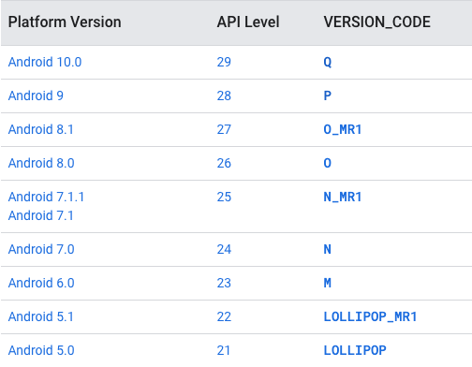
Android releases and API levels
Notes:
Android devices may be running different versions of Android. Each Android release has a:
Platform Version
API level (for developers)
Version Code —- letters with sweet treats - still occasionally used when talking about Android
As new versions of Android are released, developers need to stay up-to-date with the latest best practices to ensure their apps deliver the best experience on as many devices as possible. To find out about the latest versions, their API levels, and the devices they support, check What is API Level?

Slide 9
Choose API levels for your app
Minimum SDK: Device needs at least this API level to install
Target SDK: API version and highest Android version tested
Compile SDK: Android OS library version compiled with
minSdkVersion <= targetSdkVersion <= compileSdkVersion
The API level identifies the framework API version of the Android SDK.
Notes:
When you create an Android project, you'll need to define three API levels:
The minimum required for a user to install your app
The user version you are targeting
The version to use to compile your app
Note that the minimum SDK version has to be less than or equal to the target SDK version, which has to be less than or equal to the compile SDK version.
As new releases of Android come out, it is good practice to compile and test your app against the latest version of the platform, and increment the compileSdk and targetSdk levels.
Resources:
What is API Level?
Picking your compileSdkVersion, minSdkVersion, and targetSdkVersion

Slide 10
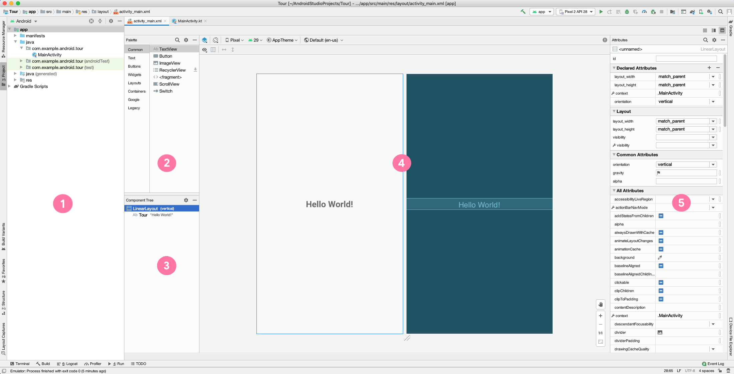
Tour of Android Studio
Notes:
In this view of Android Studio, you can see the Project window and the Layout Editor. The Layout Editor includes a Palette, a Component Tree, a Design Editor, and an Attributes window.
Project window shows the files and folders for your project.
Palette shows the components and layouts that you can drag into your project, such as TextViews, ImageViews, and Buttons.
Component Tree shows the view hierarchy for your layout. Click a component or layout to show it in the Design Editor.
Design Editor displays a Design view and a Blueprint view to give you a visual representation of your layout.
Attributes window contains a list of properties you can set for your component.
Resource:
Meet Android Studio

Slide 11
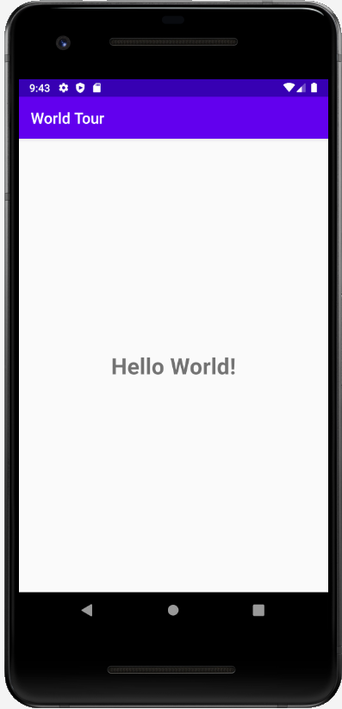
Run your app
Android device (phone, tablet)
Emulator on your computer

Slide 12
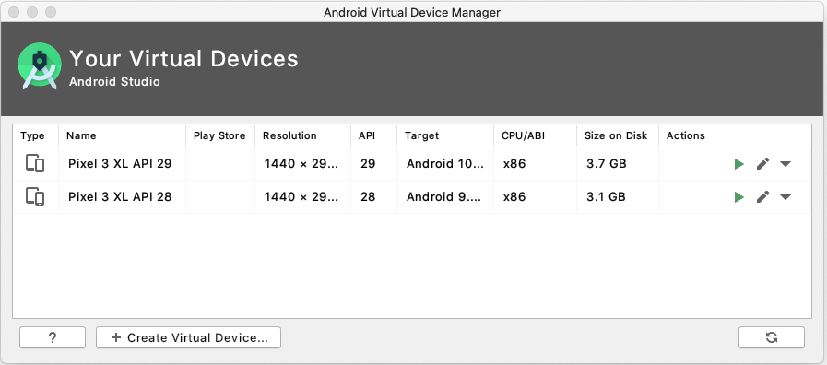
Android Virtual Device (AVD) Manager
Notes:
In addition to running your app on a physical device, you can use the emulator to emulate many different Android form factors with the help of the Android Virtual Device (AVD) Manager.
Note that you’ll need to download each system image that you want to emulate, since there are many possible options.

Slide 13
Anatomy of an Android App
project

Slide 14
Anatomy of a basic app project
Activity
Resources (layout files, images, audio files, themes, and colors)
Gradle files
Notes:
In a basic app project, the main parts to know about are the Activity, the app’s resources, and the gradle files. We’ll cover each topic in more depth in this lesson, but briefly:
An Activity handles user input and creates a window on the screen to display your user interface.
Resources are additional files that your code uses, such as layout files, images, audio files, themes, colors, and more.
Gradle files are scripts that control how your app is built, so that it can be installed on a device.

Slide 15
Android app project structure
MyApplication
├── app
│ ├── libs
│ └── src
│ ├── androidTest
│ ├── main
│ │ ├── java
│ │ ├── res
│ │ └── AndroidManifest.xml
│ └── test
├── build.gradle
└── gradlew
Notes:
When you create your first app from a project template, Android Studio generates a project structure similar to this.
Here’s what each file or directory does:
app - stores source code, tests, and resources for your app
libs - stores local libraries your app depends on
androidTest - test code that’s specific to Android
main - Java and Kotlin app files
test - local unit tests that will execute on your computer
AndroidManifest.xml - declares essential information for your app
build.gradle - controls how your application builds, tests, and deploys itself
gradlew - an executable to run gradle, even if it is not already installed

Slide 16
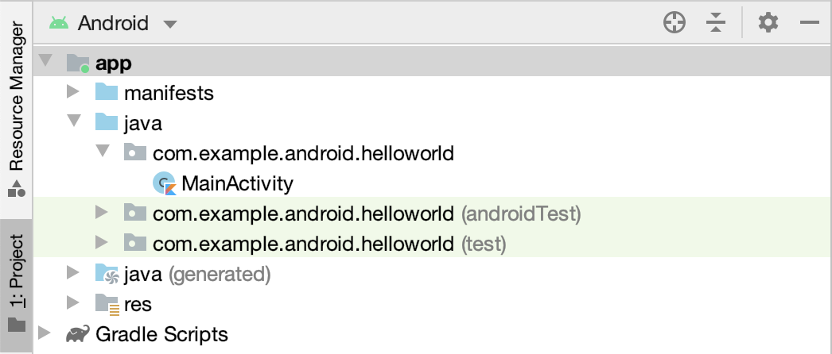
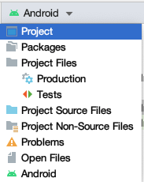
Browse files in Android Studio
Notes:
Using Android Studio’s Project window, you can browse project files for your app. The Android view, which shows by default (image on the left), is structured for easy access to the files you need for app development. However, the Android view doesn’t reflect the actual file structure of your app (what you would see using the file explorer on your computer). To see how the folders and files actually look on your computer, switch to the Project view in the drop down menu (shown on the right). Feel free to use whichever view you prefer.
Resource:
Project Files

Slide 17
Layouts and resources in Android

Slide 18
Views
Views are the user interface building blocks in Android
Bounded by a rectangular area on the screen
Responsible for drawing and event handling
Examples: TextView, ImageView, Button
Can be grouped to form more complex user interfaces
Notes:
Android comes with a large set of built-in classes for views (sometimes called widgets). For example, TextView, ImageView, and Button are commonly used views. Each View has different attributes depending on the type of View it is. Example attributes include width, height, whether it is visible, and more. For a TextView, example attributes include font size, font family, and the text to display.
Resources:
TextView
ImageView
Button

Slide 19
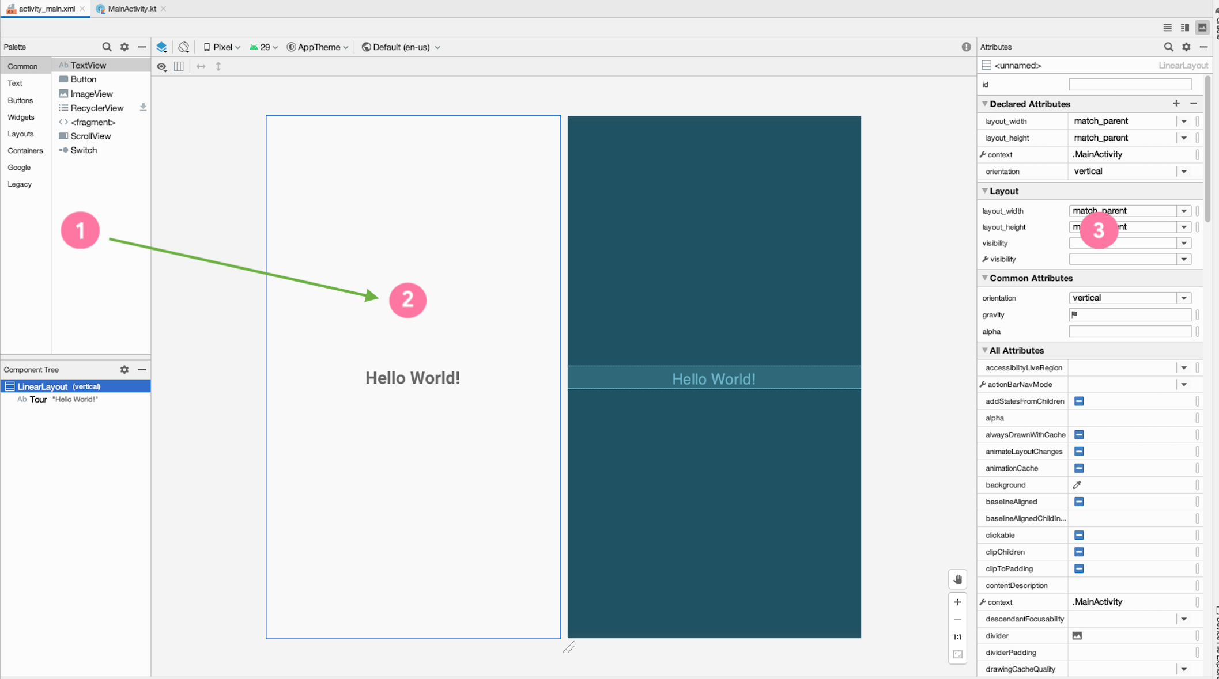
Layout Editor
Notes:
In Android Studio, build your layout with the Layout Editor.
Drag and drop components from the Palette (1) into the Design view (2).
See a preview of your layout in the Design view (2).
Modify the attributes of the views on the right hand side in the Attributes window (3).
Resource:
Build a UI with Layout Editor

Slide 20
XML Layouts
You can also edit your layout in XML.
Android uses XML to specify the layout of user interfaces (including View attributes)
Each View in XML corresponds to a class in Kotlin that controls how that View functions

Slide 21
XML for a TextView
<TextView
android:layout_width="wrap_content"
android:layout_height="wrap_content"
android:text="Hello World!"/>
Hello World!
Notes:
Here’s the XML for displaying a TextView in the layout. We see three attributes on the TextView: width, height, and text. These attributes are provided by either the base View class (width and height) or by the specific TextView class.

Slide 22
Size of a View
wrap_content
android:layout_width="wrap_content"
match_parent
android:layout_width="match_parent"
Fixed value (use dp units)
android:layout_width="48dp"
Notes:
Android has several ways to specify the width and height of a View. These examples are for the layout_width of a View, but the same applies for the layout_height attribute of a View.
Use wrap_content to use only as much space as needed to display the content within the View. For example, if you want the View to be as wide as the text within the TextView, use wrap_content.
Use match_parent to use the dimension of the parent (such as matching the width of the parent View). For example, if you want the ImageView to take up the full size of the parent, set match_parent for its width and height.
Lastly, if you want a fixed size for the View, then set a specific dp (density-independent pixels) value. We will be revisiting the concept of dps in the next lesson when we learn more about layouts.

Slide 23
ViewGroups
A ViewGroup is a container that determines how views are displayed.
FrameLayout
LinearLayout
ConstraintLayout
TextView
TextView
TextView
TextView
TextView
Button
Button
The ViewGroup is the parent and the views inside it are its children.
Notes:
To show more than one view on screen, use a ViewGroup. A ViewGroup is a container for views, and controls how views are organized and laid out on screen. This slide shows examples of three different ViewGroups.
Use a FrameLayout if you have only one child View.
Use a LinearLayout to display views in a row or column.
Use a ConstraintLayout for more complex layouts.
In general, choose the ViewGroup that meets your needs without being overly complex. For example, if you can get the job done with a LinearLayout, then there is no need to use a ConstraintLayout.
Let’s look at the XML for some of these ViewGroups.

Slide 24
FrameLayout example
A FrameLayout generally holds a single child View.
<FrameLayout
android:layout_width="match_parent"
android:layout_height="match_parent">
<TextView
android:layout_width="match_parent"
android:layout_height="match_parent"
android:text="Hello World!"/>
</FrameLayout>
TextView
Notes:
In this example, the FrameLayout holds a single TextView. Note that the closing tag of the FrameLayout comes after the child TextView.
You can think of FrameLayout as a picture frame. It’s only meant to show one thing, so use it to hold a single child View. If you add more than one child within it, the views would overlap, which may be the desired behavior in some cases.

Slide 25
LinearLayout example
Aligns child views in a row or column
Set android:orientation to horizontal or vertical
<LinearLayout
android:layout_width="match_parent"
android:layout_height="match_parent"
android:orientation="vertical">
<TextView ... />
<TextView ... />
<Button ... />
</LinearLayout>
TextView
TextView
Button
Notes:
Here’s an XML example for the LinearLayout ViewGroup. LinearLayout is the parent for the three child views (two TextViews and a Button).
A LinearLayout lays out child views in a row or column. The layout direction is determined by the orientation attribute on the LinearLayout. In this case, the LinearLayout has a “vertical” orientation, so the layout will look like this diagram. Change the orientation to “horizontal” to have the views grouped in a horizontal row.

Slide 26
View hierarchy
ImageView
LinearLayout
TextView
ImageView
TextView
LinearLayout
Button
Button
Button
Button
Notes:
We’ve talked about how views can have parent - child relationships if they’re placed within a ViewGroup. ViewGroups can also contain other ViewGroups. This creates a hierarchy of views that represent the layout of what’s displayed on the screen (on the right).

Slide 27
App resources
Static content or additional files that your code uses
Layout files
Images
Audio files
User interface strings
App icon
Notes:
In addition to defining your own layouts, you can also add your own images, audio files, strings, app icon, and other resources to the app. Android provides a robust system to access them from anywhere in your app.

Slide 28
Common resource directories
Add resources to your app by including them in the appropriate resource directory under the parent res folder.
main
├── java
└── res
├── drawable
├── layout
├── mipmap
└── values
Notes:
The drawable directory stores all files related to drawing images and related assets.
The layout directory contains all the layout XML files for your application. There may be more than one if your app needs to handle different orientations or densities.
The mipmap directory contains files for your app icon (known as your launcher icon) at different screen densities.
The values directory contains files related to simple collections of strings, colors, integers, and styles. If you are localizing your app, you might have more than one values directory.
There are more subdirectories that may appear in the resources directory, but these are the ones that will be present in almost every Android project.

Slide 29
Resource IDs
Each resource has a resource ID to access it.
When naming resources, the convention is to use all lowercase with underscores (for example, activity_main.xml).
Android autogenerates a class file named R.java with references to all resources in the app.
Individual items are referenced with: R.<resource_type>.<resource_name>
Examples:
R.drawable.ic_launcher (res/drawable/ic_launcher.xml)
R.layout.activity_main (res/layout/activity_main.xml)

Slide 30
Resource IDs for views
Individual views can also have resource IDs.
Add the android:id attribute to the View in XML. Use @+id/name syntax.
<TextView
android:id="@+id/helloTextView"
android:layout_width="wrap_content"
android:layout_height="wrap_content"
android:text="Hello World!"/>
Within your app, you can now refer to this specific TextView using:
R.id.helloTextView
Notes:
If you assign IDs to the views in your layout, you can access them using R.id.<resource_name>. For example, this TextView has the resource ID name “helloTextView” and you can refer to it in your app using R.id.helloTextView. Be sure to use unique resource names so it is clear which element you want to refer to.

Slide 31
Activities

Slide 32
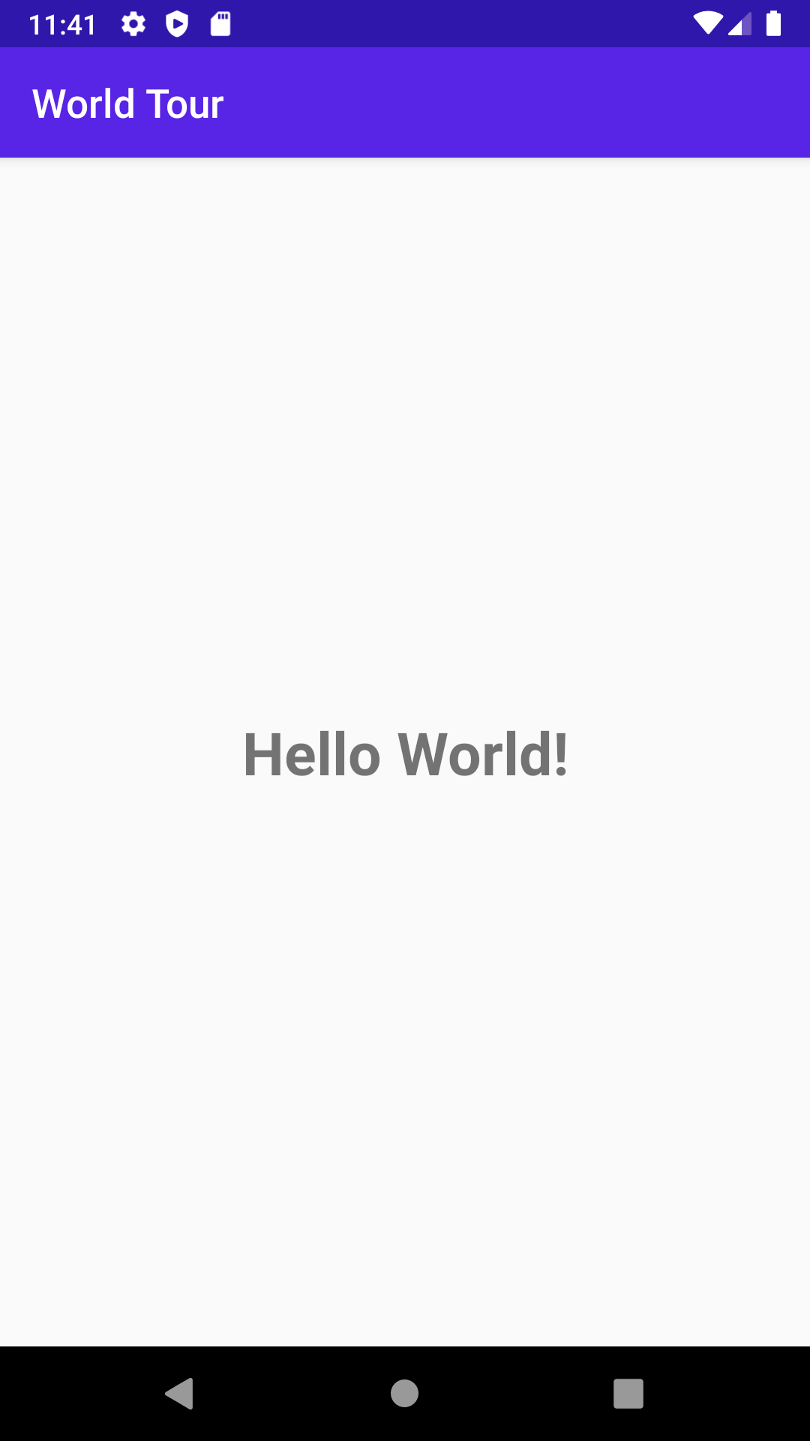
What’s an Activity?
An Activity is a means for the user to accomplish one main goal.
An Android app is composed of one or more activities.
Notes:
Examples of activities:
Displaying a list of emails
Displaying details of one specific item
Taking a photo using the camera

Slide 33
MainActivity.kt
class MainActivity : AppCompatActivity() {
override fun onCreate(savedInstanceState: Bundle?) {
super.onCreate(savedInstanceState)
setContentView(R.layout.activity_main)
}
}
Notes:
Let’s look at the code in MainActivity.kt. This was automatically generated because we selected the Empty Activity template in the new project wizard. Notice that it says “class” MainActivity.
It extends from the AppCompatActivity class, where we inherit behavior from the Android framework about how an Activity works. AppCompat for app compatibility ensures that newer features are available to legacy versions of Android.
Within the class, we have one function that is overriding the onCreate function that was defined in the superclass.

Slide 34
How an Activity runs
Activity launched
onCreate()
App is running
Activity shut down
Notes:
Instead of launching a program through the main() function, as shown in earlier lessons, Android starts your app through an Activity instance.
Once the user taps your app icon on the device, Android opens your app by launching the main Activity of your app. Specifically, the onCreate() method is called when your Activity is created. The onCreate() method is just one of the Activity callback methods that is invoked from the system at certain stages of the Activity lifecycle. We’ll talk more about the lifecycle in a future lesson. For now, know that your Activity continues to run until the user or system takes action to shut it down.
Resource:
Introduction to Activities

Slide 35
Implement the onCreate() callback
Called when the system creates your Activity
override fun onCreate(savedInstanceState: Bundle?) {
super.onCreate(savedInstanceState)
setContentView(R.layout.activity_main)
}
Notes:
Here’s what the onCreate() method looks like in the MainActivity.kt file of our sample app. In this callback method, we call into the superclass onCreate() method to set up the Activity. The Android framework handles a lot of this complexity for us. Then we call setContentView() so that the layout defined in the activity_main.xml file is displayed in the Activity. Let’s look at what happens when we call setContentView with a layout resource ID.
Resource:
onCreate()

Slide 36
Layout inflation
Activity
ViewGroup
Layout files
LayoutInflater
View1
layout1
layout2
layout3
ViewGroup
View2
View3
Notes:
The layout XML file is parsed by a LayoutInflater and a hierarchy of View objects is created to be displayed in the Activity. This process is called layout inflation.
Resource:
setContentView

Slide 37
Make an app interactive
Notes:
So far, we’ve talked about what goes into displaying a layout in your app. But eventually you'll want an app that can respond to user input, and provide different behavior accordingly.

Slide 38
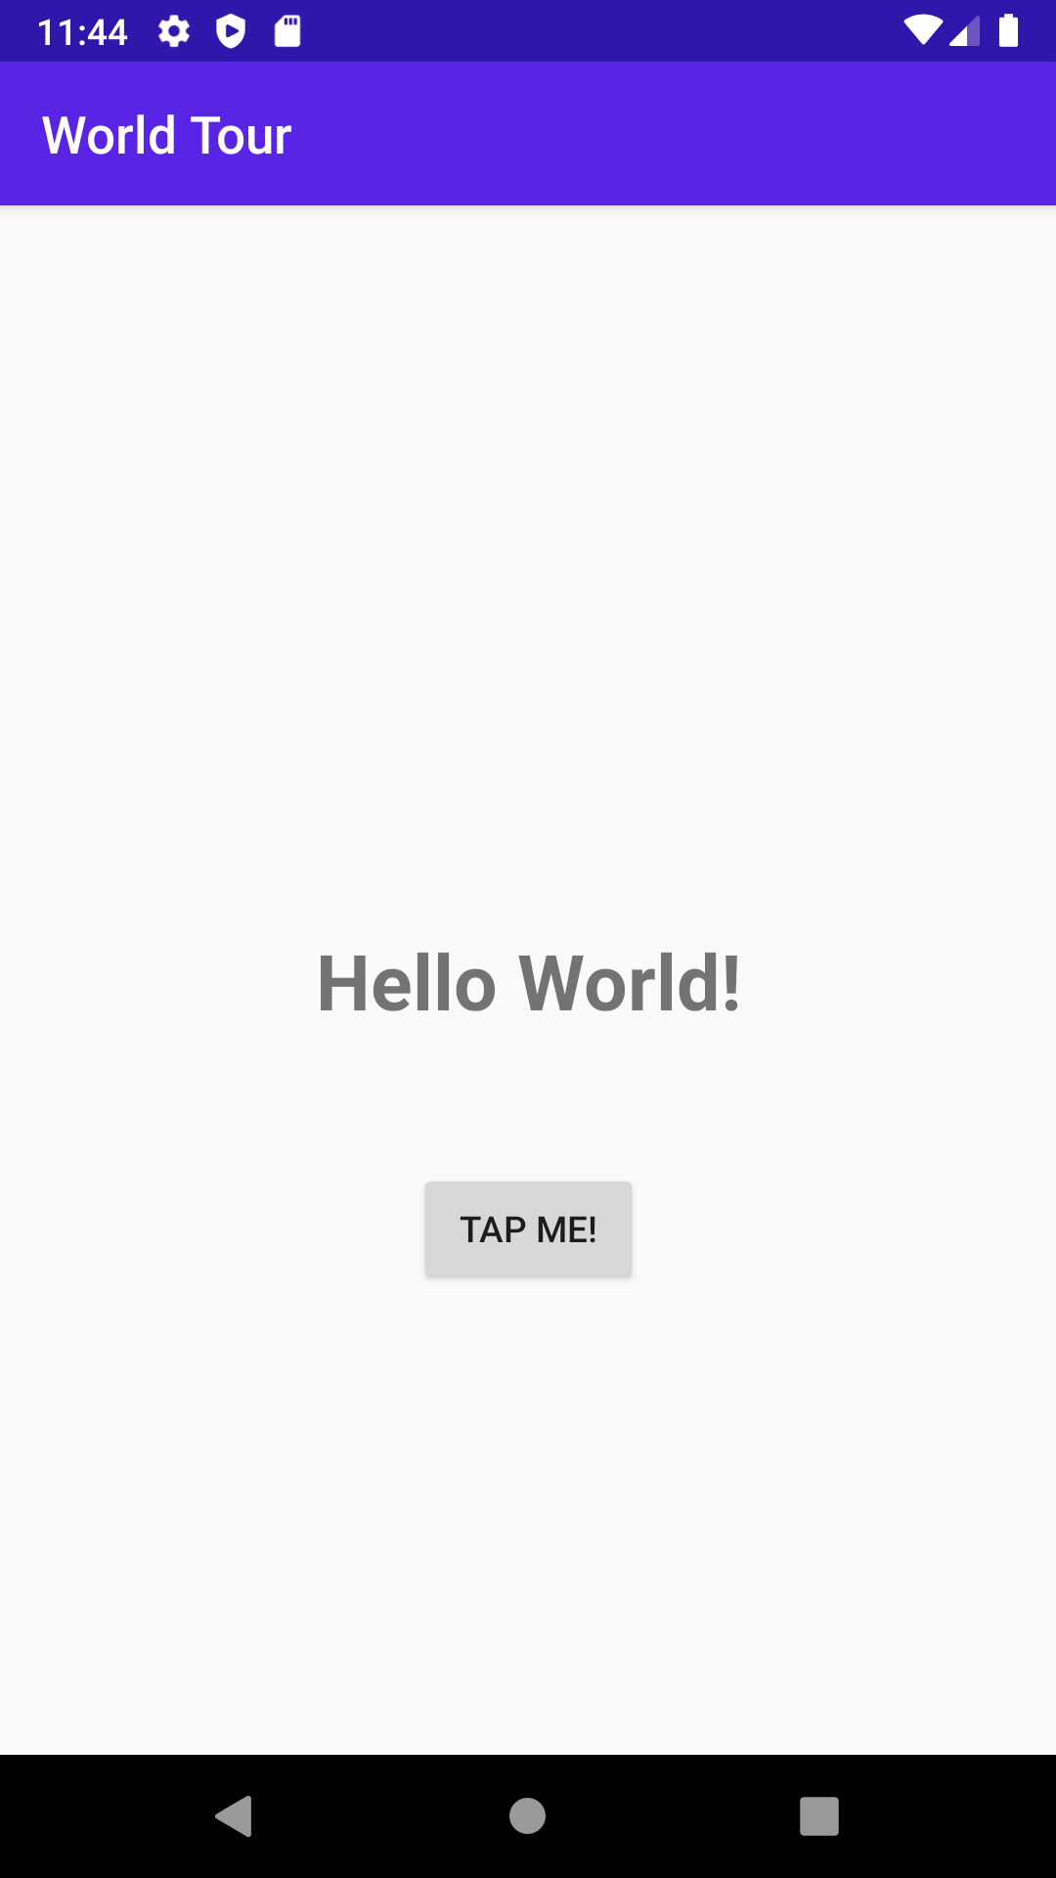
Define app behavior in Activity
Modify the Activity so the app responds to user input, such as a button tap.
Notes:
You can define how your app will behave in the Activity file of your app. For example, you can modify the MainActivity so that the "Hello World" is displayed when the button is tapped.

Slide 39
Modify a View dynamically
Within MainActivity.kt:
Get a reference to the View in the view hierarchy:
val resultTextView: TextView = findViewById(R.id.textView)
Change properties or call methods on the View instance:
resultTextView.text = "Goodbye!"
Notes:
Within the MainActivity, you can also dynamically modify the views in your layout. For example, you can get a reference to the TextView object instance in your View hierarchy using the findViewById() method, and passing in the resource ID for that TextView. Then you can change properties or call methods on the TextView. For example, setting resultTextView.text equal to the “Goodbye!” string changes what gets displayed in the TextView.

Slide 40
Set up listeners for specific events
User interacts with a View
An event is fired
Did developer register a callback?
No
Yes
Ignore the event
Execute the callback
Notes:
You can also set up listeners for certain things to happen based on user input. The base View class has a set of events that you can register callbacks to respond to. View.OnClickListener is the one you’ll interact with the most.
Resource:
View.OnClickListener

Slide 41
View.OnClickListener
class MainActivity : AppCompatActivity(), View.OnClickListener {
override fun onCreate(savedInstanceState: Bundle?) {
...
val button: Button = findViewById(R.id.button)
button.setOnClickListener(this)
}
override fun onClick(v: View?) {
TODO("not implemented")
}
}
Notes:
Let’s look at the code for how to set an OnClickListener on a View.
First we need to create the OnClickListener. In this case, we have the MainActivity implement the OnClickListener interface, and override the onClick() method.
Then we set the click listener (this) on the Button when the Activity is created.
Note that the onClick() method takes the View as a parameter allowing you to use the same onClick() function with different views.
Resources:
View.OnClickListener

Slide 42
SAM (single abstract method)
Converts a function into an implementation of an interface
Format: InterfaceName { lambda body }
val runnable = Runnable { println("Hi there") }
is equivalent to
val runnable = (object: Runnable {
override fun run() {
println("Hi there")
}
})
Notes:
Transition: 1 click
Another way to define an OnClickListener is creating a class that implements the interface. Since the interface for View.OnClickListener has a single Single Abstract Method (SAM), Kotlin function literals can be automatically converted into an implementation of this interface. (The parameter types of the interface method must match the parameter types of the Kotlin function.)
Resource:
SAM Conversions

Slide 43
View.OnClickListener as a SAM
A more concise way to declare a click listener
class MainActivity : AppCompatActivity() {
override fun onCreate(savedInstanceState: Bundle?) {
...
val button: Button = findViewById(R.id.button)
button.setOnClickListener({ view -> /* do something*/ })
}
}

Slide 44
Late initialization
class Student(val id: String) {
lateinit var records: HashSet<Any>
init {
// retrieve records given an id
}
}
Notes:
Let’s talk about one more Kotlin concept that we can leverage.
In the last lesson, we learned that Kotlin has a strong preference for null safety. As you're creating apps, you’ll find yourself needing to create properties or fields that may depend on function calls such as onCreate. One option is to make the type nullable and set the initial value to null. That means each use would need to have a null check. You can avoid having to do this by using lateinit, which just tells the Kotlin compiler that you're responsible for the initialization. If you attempt to use your lateinit field or property before initializing, an exception will be thrown.
Resource:
lateinit

Slide 45
Lateinit example in Activity
class MainActivity : AppCompatActivity() {
lateinit var result: TextView
override fun onCreate(savedInstanceState: Bundle?) {
...
result = findViewById(R.id.result_text_view)
}
}
Notes:
In our MainActivity class, we can’t initialize the result TextView until the layout has been inflated. So wait until the onCreate() method to get a reference to the TextView in the layout to initialize the result TextView. Then you are free to use the result property and be certain that it won’t be null. If you use the property before it’s initialized, an exception is thrown.

Slide 46
Gradle: Building an
Android app
Notes:
Let’s move onto the last section of our lesson today. If you remember, the anatomy of a basic app includes an Activity, resources and layouts, and Gradle files. Let’s discuss Gradle.
Building an app is complex, and there are specific tasks that have a sequence they must run in. Android uses Gradle to manage these tasks and build your app.

Slide 47
What is Gradle?
Builds automation system
Manages the build cycle via a series of tasks (for example, compiles Kotlin sources, runs tests, installs app to device)
Determines the proper order of tasks to run
Manages dependencies between projects and third-party libraries
Notes:
Gradle uses a directed acyclic graph to determine which tasks are required for the intended tasks, what order to run them in, and then runs them.

Slide 48
Gradle build file
Declare plugins
Define Android properties
Handle dependencies
Connect to repositories
Notes:
It appears like a simple text file, but it's more than that. It’s code with a bit of (Groovy) magic. Let’s look at parts of the Gradle build file.

Slide 49
Plugins
Provide libraries and infrastructure needed by your app
apply plugin: 'com.android.application'
apply plugin: 'kotlin-android'
apply plugin: 'kotlin-android-extensions'
Notes:
A build.gradle file will usually include a plugin section where the build script declares which plugins will be applied. Plugins provide additional functionality as supplementary tasks and dependencies freeing you as a developer from having to declare all the dependencies.

Slide 50
Android configuration
android {
compileSdkVersion 30
buildToolsVersion "30.0.2"
defaultConfig {
applicationId "com.example.sample"
minSdkVersion 19
targetSdkVersion 30
}
}
Notes:
In the Android configuration block, you set the specifics of what makes your app run on Android, such as SDK versions, test runners, build targets, and so forth.

Slide 51
Dependencies
dependencies {
implementation "org.jetbrains.kotlin:kotlin-stdlib-jdk7:$kotlin_version"
implementation 'androidx.core:core-ktx:1.3.2'
implementation 'androidx.appcompat:appcompat:1.2.0'
implementation 'com.google.android.material:material:1.2.1'
...
}
Notes:
When you create an Android app, you aren’t expected to create everything from scratch. The dependencies block lets you refer to libraries you want to use, either locally or remote, in a standardized way to make sure they have any sub-dependencies they need, and don’t conflict with one another. This is another reason it’s important to organize your code in packages.

Slide 52
Repositories
repositories {
google()
jcenter()
maven {
url "https://maven.example.com"
}
}
Notes:
Out on the web, there are collections of libraries organized in repositories. Use the repositories block to specify where to look for them. Gradle will start at the first listed repository and fall through to each subsequent one if it doesn’t find the resource.

Slide 53
Common Gradle tasks
Clean
Tasks
InstallDebug
Notes:
The clean task deletes all compiled files from the build directory.
Tasks outputs a list of tasks for your project and any installed plugins.
InstallDebug compiles the app if necessary, builds a debug APK, and installs it on a connected physical or emulated device.
You typically won’t need to run Gradle from the command line; you should be able to run any needed tasks directly from Android Studio.

Slide 54
Accessibility
Notes:
Before we wrap up this lesson, let’s discuss another important topic to keep in mind as you build Android apps.
Android apps should aim to be usable by everyone, including people with accessibility needs.

Slide 55
Accessibility
Refers to improving the design and functionality of your app to make it easier for more people, including those with disabilities, to use
Making your app more accessible leads to an overall better user experience and benefits all your users
Notes:
Note: You may see accessibility abbreviated as "a11y".

Slide 56
Make apps more accessible
Increase text visibility with foreground and background color contrast ratio:
At least 4.5:1 for small text against the background
At least 3.0:1 for large text against the background
Use large, simple controls
Touch target size should be at least 48dp x 48dp
Describe each UI element
Set content description on images and controls
Notes:
Here are some tips on how to make your app more accessible.
Resources:
Make apps more accessible
Color contrast
Label elements

Slide 57
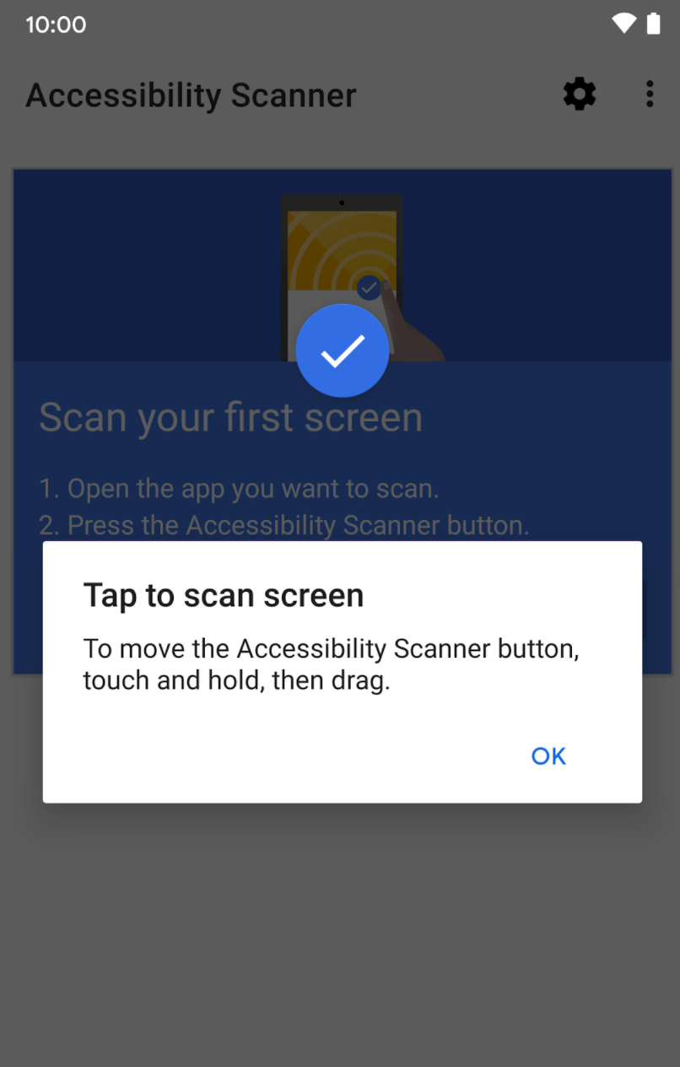
Accessibility Scanner
Tool that scans your screen and suggests improvements to make your app more accessible, based on:
Content labels
Touch target sizes
Clickable views
Text and image contrast
See: https://youtu.be/i1gMzQv0hWU
Notes:
The Accessibility Scanner is a useful tool to identify opportunities to improve your app in terms of accessibility.
Permissions Notice: Because this app is an accessibility service, it can observe your actions, retrieve window content, and observe text that you type.
If you are okay with these permissions, download the Accessibility Scanner app from Google Play and turn it on under the Settings > Accessibility menu. Then open the app you want to scan on your device, and follow the prompts to scan your app screen.
Resources:
Accessibility Scanner app on Google Play
Accessibility Scanner Support Guide

Slide 58
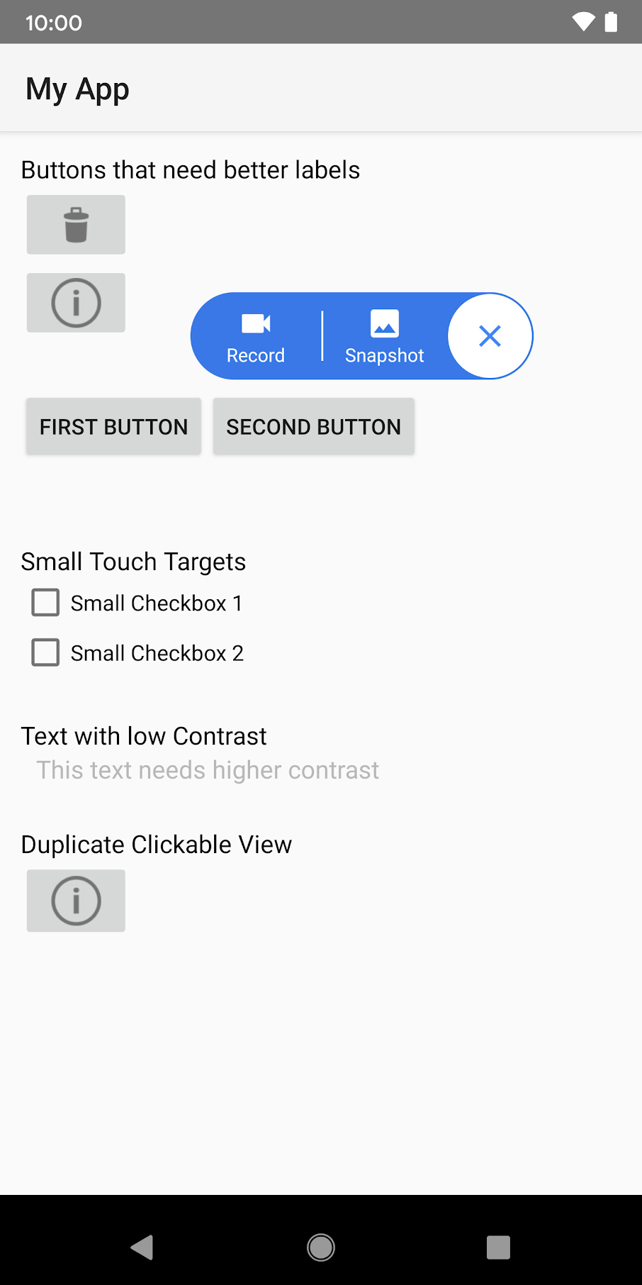
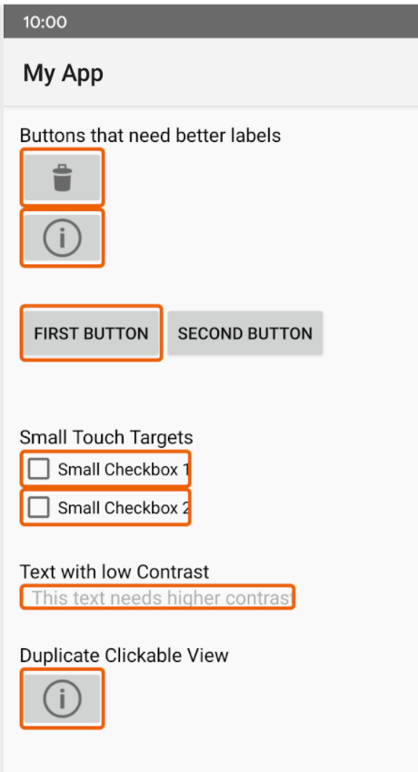
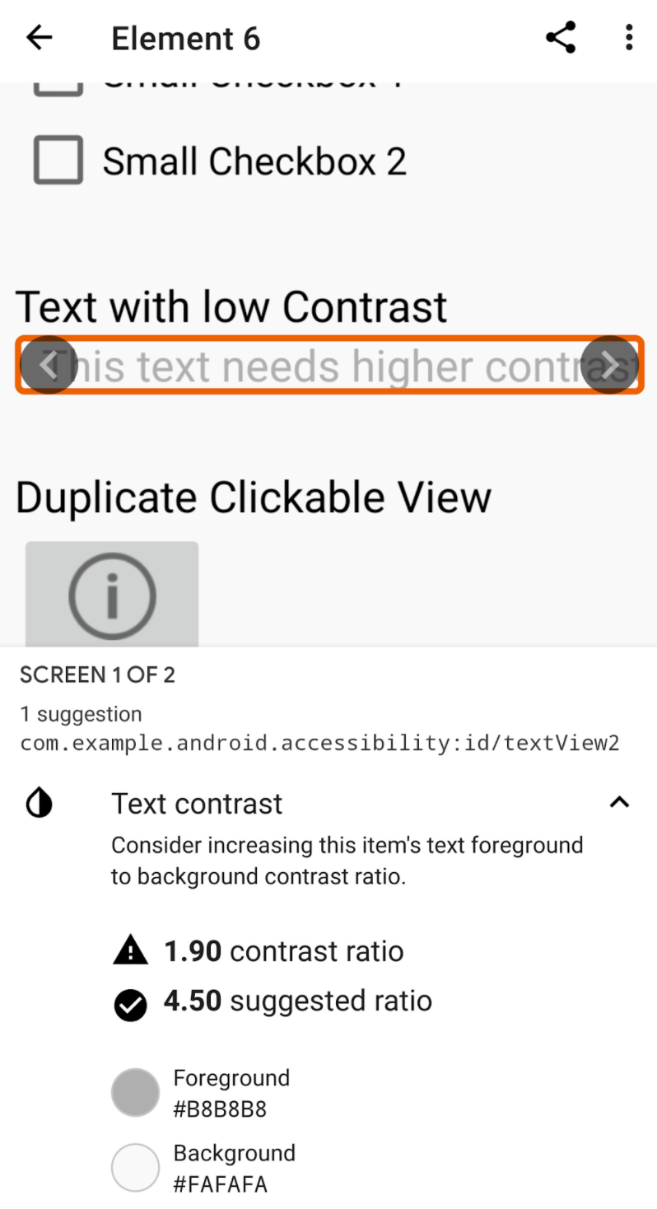
Accessibility Scanner example
Notes:
In this example, the scanner has found buttons that need better labels, checkboxes that are too small to be easily touched, text with low contrast that is difficult to read, and a duplicate clickable view. Making these suggested improvements will improve the user experience for your app.
Note that this app may not catch all issues, so you should still verify with other means that your app adheres to accessibility guidelines.

Slide 59
Add content labels
Set contentDescription attribute → read aloud by screen reader
<ImageView
...
android:contentDescription="@string/stop_sign" />
Text in TextView already provided to accessibility services, no additional label needed
Notes:
Other recommended best practices:
Don’t include the type of UI element (e.g., button) in the description because screen readers automatically announce the element type with the description.
Each description should be unique.
Resources:
Describe each UI element
Content labels

Slide 60
No content label needed
For graphical elements that are purely for decorative purposes, you can set
android:importantForAccessibility="no"
Removing unnecessary announcements is better for the user
Notes:
If a graphical UI element doesn’t need a content description, you can set android:importantForAccessibility="no". This means that this view is not important for accessibility.
This prevents the screen reader from having to announce non-essential information, and makes it easier for users to access the more important information more quickly.
Resource:
android:importantForAccessibility attribute

Slide 61
TalkBack
Google screen reader included on Android devices
Provides spoken feedback so you don’t have to look at the screen to use your device
Lets you navigate the device using gestures
Includes braille keyboard for Unified English Braille
Notes:
To test out that you have properly added descriptions to your app’s UI elements, use the TalkBack screen reader.
You can turn on Talkback by navigating to your device's Settings app > Accessibility. Or you can try the shortcut of pressing both volume keys for 3 seconds. If the shortcut doesn’t work, you may need to enable the shortcut in the settings menu first (see resource below).
Resources:
TalkBack screen reader
Volume key shortcut
Navigate your device with TalkBack
TalkBack gestures
TalkBack braille keyboard

Slide 62
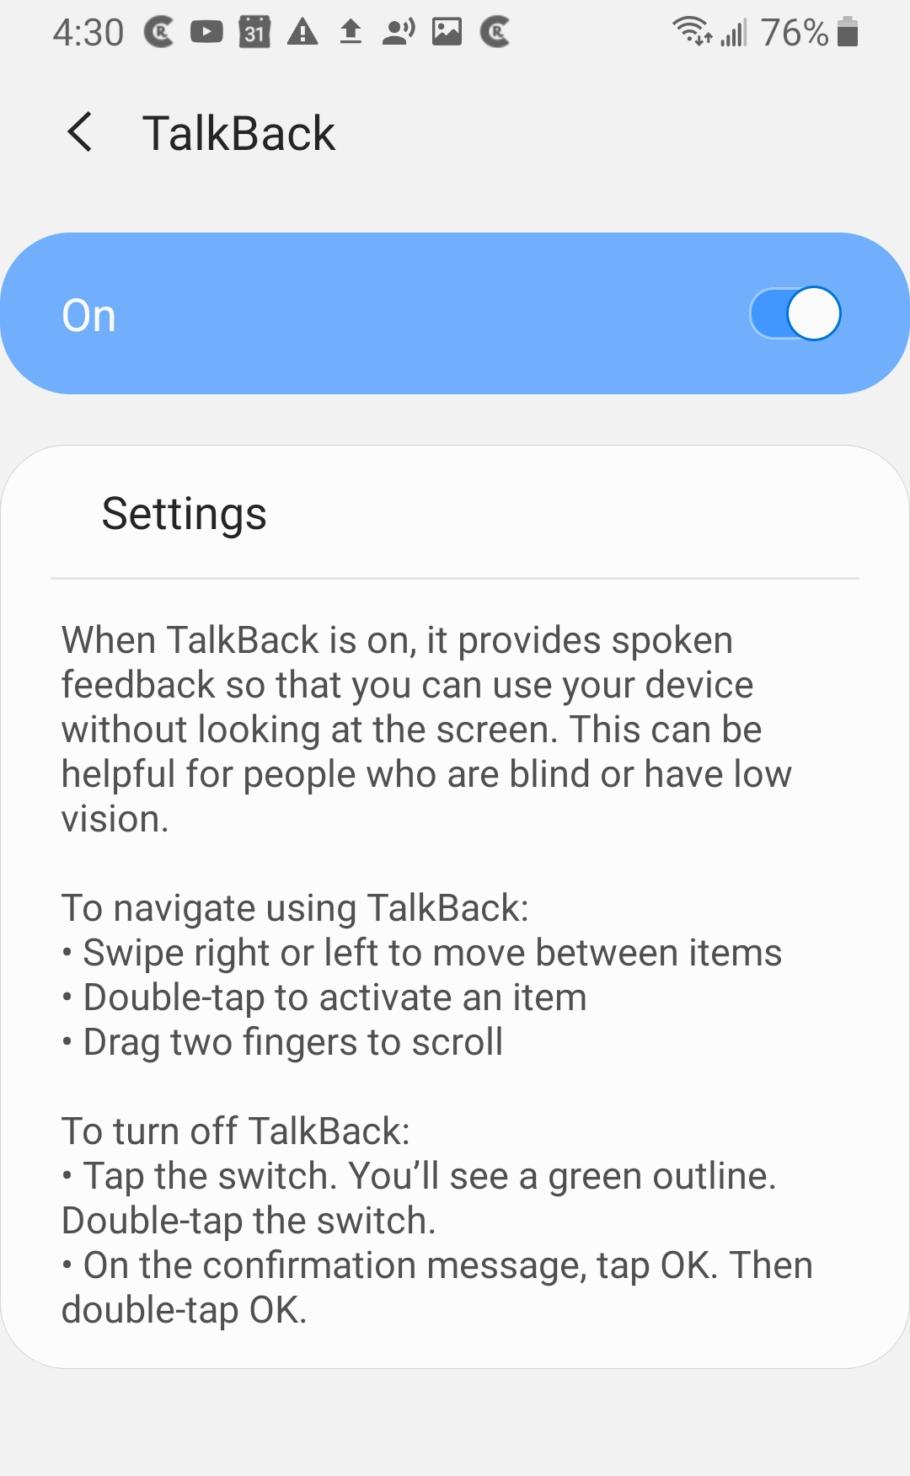
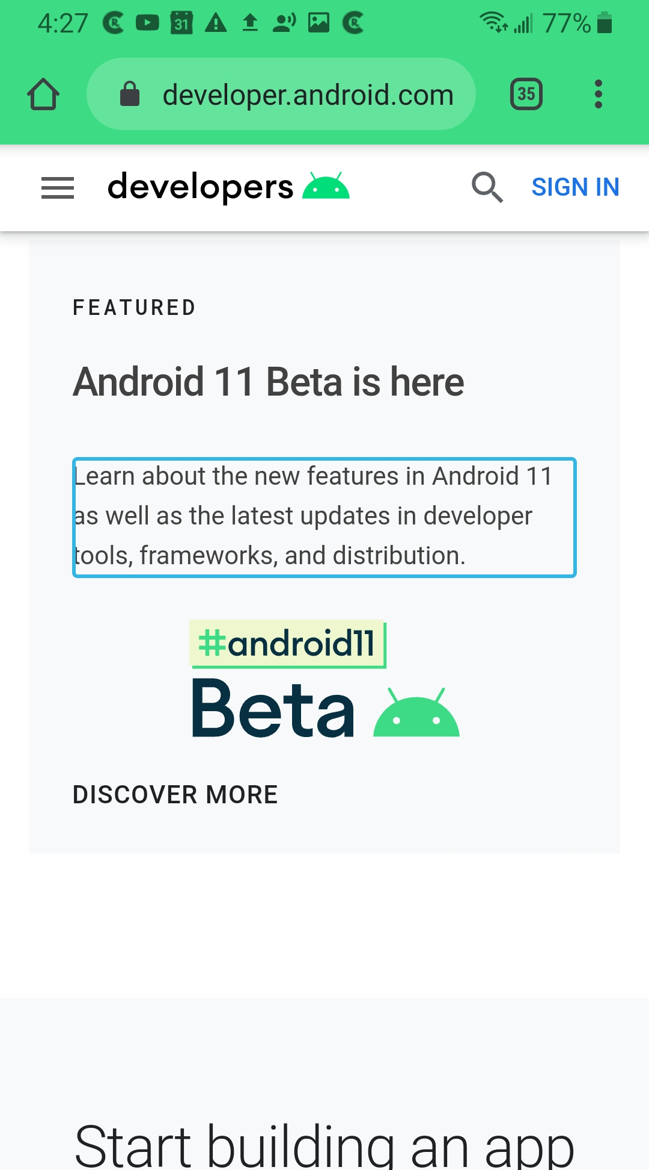
TalkBack example
Reads text aloud as user navigates the screen
Notes:
We recommend that you test your app with TalkBack turned on. For more details, see the resource below.
Resource:
Test your app’s accessibility with TalkBack

Slide 63
Switch access
Allows for controlling the device using one or more switches instead of the touchscreen
Scans your app UI and highlights each item until you make a selection
Use with external switch, external keyboard, or buttons on the Android device (e.g., volume buttons)
Notes:
We also recommend that you test your app with Switch Access turned on. See the testing guide below for more details.
Resources:
Switch Access for Android
Testing your app with Switch Access on

Slide 64
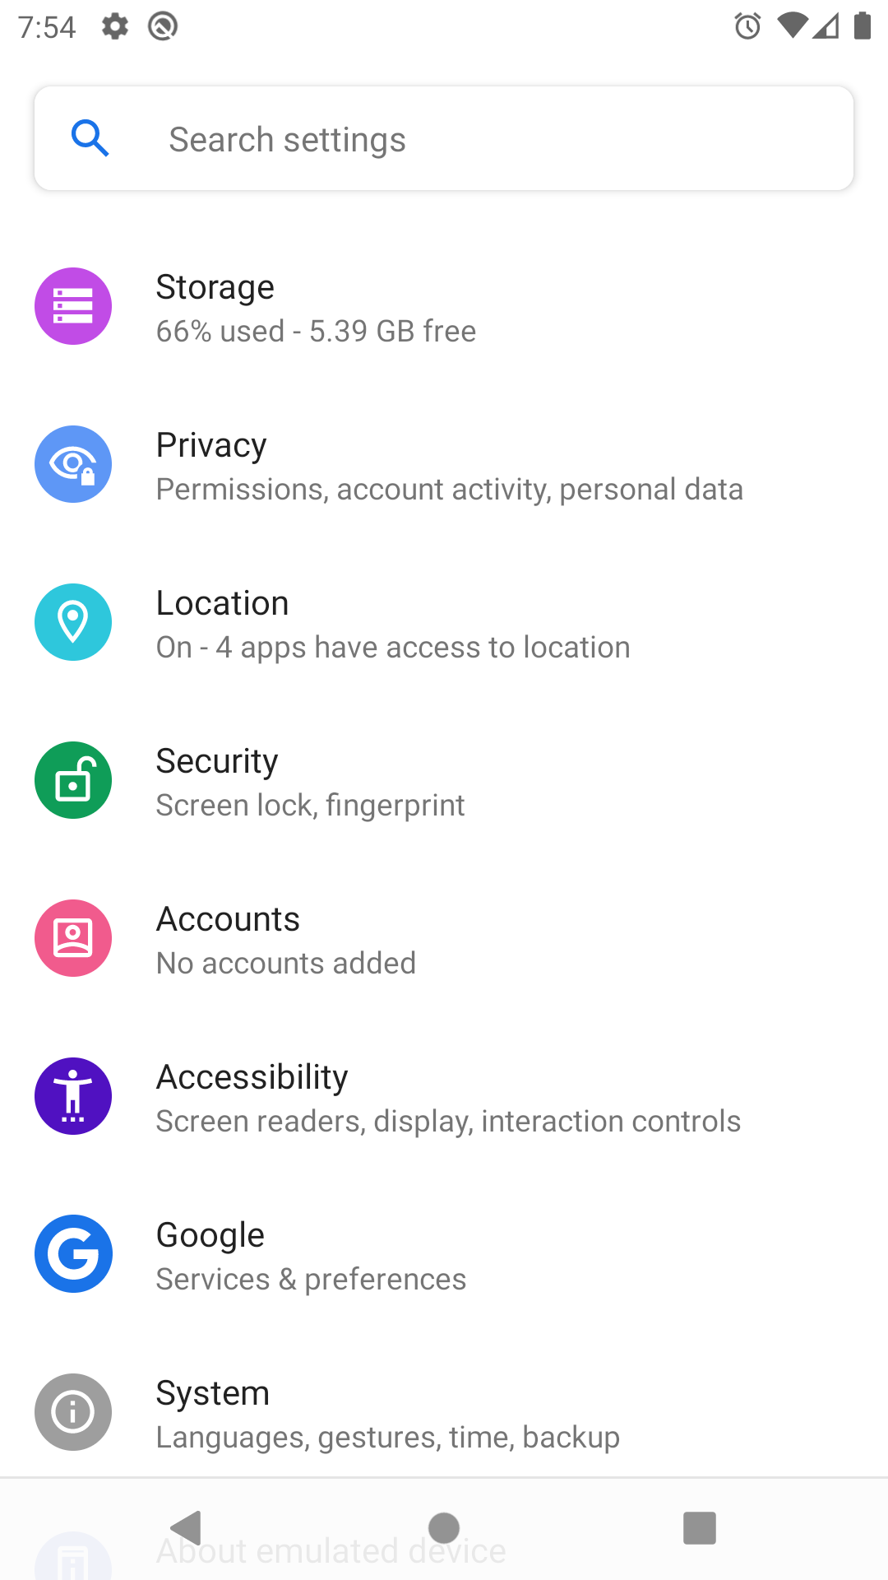
Android Accessibility Suite
Collection of accessibility apps that help you use your Android device eyes-free, or with a switch device. It includes:
Talkback screen reader
Switch Access
Accessibility Menu
Select to Speak
Notes:
TalkBack and Switch Access are part of the Android Accessibility Suite, which are built into many Android devices. There’s also the Accessibility Menu (large on-screen menu to lock your phone, control volume and brightness, take screenshots, and more), and Select to Speak (select items on your screen and hear them read aloud).
Access these accessibility features via the device's Settings > Accessibility menu.
Resource:
Android Accessibility Suite

Slide 65
Accessibility Resources
Build more accessible apps
Principles for improving app accessibility
Basic Android Accessibility codelab
Material Design best practices on accessibility

Slide 66
Summary

Slide 67
Summary
In Lesson 4, you learned how to:
Use Views and ViewGroups to build the user interface of your app
Access resources in your app from R.<resource_type>.<resource_name>
Define app behavior in the Activity (for example, register OnClickListener)
Use Gradle as the build system to build your app
Follow best practices to make your apps more accessible

Slide 68
Learn more
Layouts
LinearLayout
Input events overview
View
ViewGroup

Slide 69

Pathway
Practice what you’ve learned by completing the pathway:
Lesson 4: Build your first Android app

